Slide 1
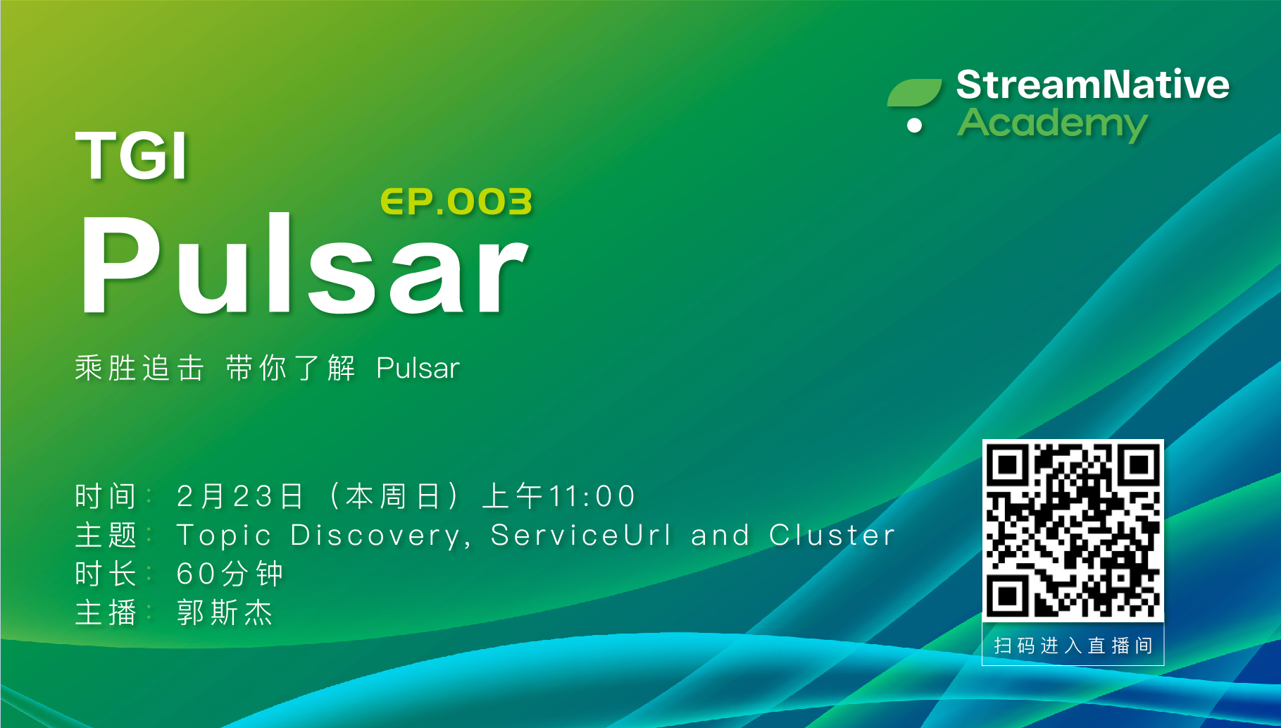

Slide 2
Topic Discovery, ServiceURL, Cluster
TGIP-CN
Episode 003

Slide 3
How does Pulsar assign topics to brokers?

Slide 4
Tenant & Namespace
persistent
://
my-tenant
/
my-namespace
/
my-topic
Topic Domain
Tenant
Namespace
Topic

Slide 5
Tenant, Namespace and Topics
Pulsar Instance
Tenant (Data Serving)
Tenant (Marketing)
Tenant (Product Safety)
NS (Microservice)
NS (ETL)
NS (Campaigns)
NS (ETL)
NS (Fraud Detection)
Topic (Customer Authentication)
Topic (Location Resolution)
Topic (Demographic classification)
Topic (Budget spend)
Topic (Acct history)
Topic (User clusterin)
Topic (Risk classification)

Slide 6
Namespace
Tenant
Namespace
T0
T1
T2
T3
T4
T5

Slide 7
Namespace Bundles
0x00000000
Tenant
Namespace
0xc0000000
0x40000000
T0
T1
T2
T3
T4
T5
0x80000000

Slide 8
Namespace Bundles
0x00000000
T2
Tenant
T0
T5
Namespace
0xc0000000
0x40000000
T3
T0
T1
T2
T3
T4
T5
T1
T4
0x80000000

Slide 9
Bundle Assignment
0x00000000
T2
T0
T5
0xc0000000
0x40000000
T3
T1
T4
0x80000000

Slide 10
Load Manager
0x00000000
T2
T0
T5
0xc0000000
0x40000000
Broker 0
Broker 1
Broker 2
Broker 3
T3
T1
T4
0x80000000

Slide 11
Load Manager - Leader Election
0x00000000
T2
T0
T5
0xc0000000
0x40000000
Broker 0
Broker 1
Broker 2
Broker 3
T3
T1
T4
0x80000000
Load Manager (Leader)

Slide 12
Load Manager - Assign bundles to brokers
0x00000000
T5
T4
T2
T0
T5
T2
T3
T1
T0
0x00000000 - 0x40000000
0x40000000 - 0x80000000
0x80000000 - 0xc0000000
0xc0000000 - 0xffffffff
0xc0000000
0x40000000
Broker 0
Broker 1
Broker 2
Broker 3
T3
T1
T4
0x80000000
Load Manager assigns namespace bundles to brokers based on load reports.
Load Manager (Leader)

Slide 13
How does Pulsar client locate owner brokers?

Slide 14
Topic Owners
Broker 0
T2
Broker 1
T4
Broker 2
Broker 3
T5
T3
T1
T0
ZooKeeper
ZooKeeper
ZooKeeper

Slide 15
Topic Lookup
Pulsar Client
Broker 0
T2
Broker 1
T4
Broker 2
Broker 3
T5
T3
T1
T0
ZooKeeper
ZooKeeper
ZooKeeper

Slide 16
Topic Lookup
Pulsar Client
1. Lookup Topic (T1)
3. Establish the persist TCP connection to the owner broker for subsequent requests
2. Lookup Result (Owner Broker = Broker 2)
Broker 0
T2
Broker 1
T4
Broker 2
Broker 3
T5
T3
T1
T0
ZooKeeper
ZooKeeper
ZooKeeper

Slide 17
HTTP Topic Lookup
Pulsar Client
1. HTTP Lookup Topic (T1)
3. Establish the persist TCP connection to the owner broker for subsequent requests
2. HTTP Lookup Result (Owner Broker = Broker 2)
Broker 0
T2
Broker 1
T4
Broker 2
Broker 3
T5
T3
T1
T0
ZooKeeper
ZooKeeper
ZooKeeper

Slide 18
Topic Lookup Summary
Topic Lookup Requests can be served by any broker
Client doesn’t have to know all the broker’s address ahead of time
DNS, Load Balancer or Multi-hosts service url can be used
Persistent TCP connection is established with owner broker for subsequent requests
Client requires connectivity to the owner broker address returned from lookup result

Slide 19
Service URL
Service URL is the access point for Pulsar clients to lookup topic ownerships
Service URL protocol
Binary
HTTP
Service URL host
DNS: pulsar://example.pulsar.local:6650
Load Balancer: pulsar://1.2.3.4:6650
Multi-Hosts: pulsar://broker-0:6650,broker-1:6650,broker-3:6650

Slide 20
If a client can not access the broker address directly?

Slide 21
Add Proxies
Proxies allow for load balancing across Pulsar brokers
Proxies
Producer
Consumer
Producers send data through the proxies and do not interact with brokers
Consumers receive data through the proxies and do not interact with brokers
Brokers
Bookies

Slide 22
Topic Lookup with Proxies
Pulsar Client
1. Lookup Topic (T1)
Proxies
3. Establish the persist TCP connection to the owner broker for subsequent requests
2. Lookup Result (Owner Broker = Broker 2)
Broker 0
T2
Broker 1
T4
Broker 2
Broker 3
T5
T3
T1
T0
ZooKeeper
ZooKeeper
ZooKeeper

Slide 23
Cluster
Identified by a cluster-name
Cluster name is used for configuring geo-replication
Cluster configuration
Web service url (http://)
Web service url tls (https://)
Broker service url (pulsar://)
Broker service url tls (pulsar+ssl://)

Slide 24
Cluster Setup
$ bin/pulsar initialize-cluster-metadata \
--cluster pulsar-cluster-1 \
--zookeeper zk1.us-west.example.com:2181 \
--configuration-store zk1.us-west.example.com:2181 \
--web-service-url http://pulsar.us-west.example.com:8080 \
--web-service-url-tls https://pulsar.us-west.example.com:8443 \
--broker-service-url pulsar://pulsar.us-west.example.com:6650 \
--broker-service-url-tls pulsar+ssl://pulsar.us-west.example.com:6651

Slide 25
Cluster Operations
Create
Get
Update
List

